Slide 1
WEEK 4

Slide 2
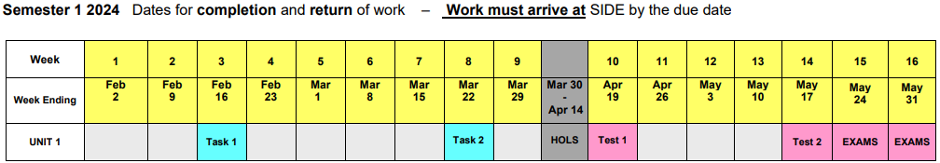
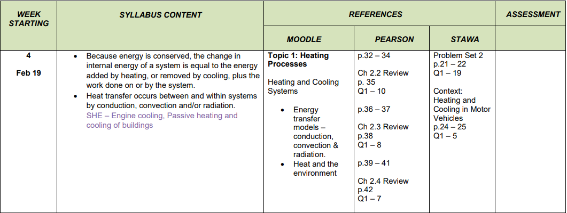

Slide 3
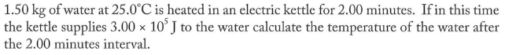
Problem 2

Slide 4
Learning Intentions
Understand and describe the 3 methods of heat transfer – conduction, convection and radiation
Describe the operation of both evaporative and refrigerative air-conditioning
Apply your knowledge of heat transfer to applications such as housing materials and thermos flasks

Slide 5
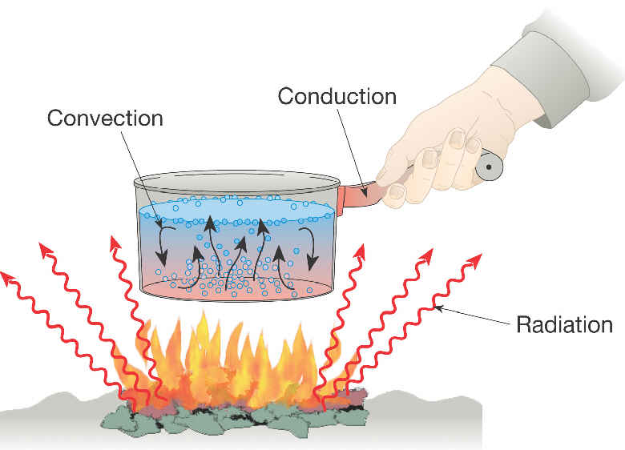
Heat transfer

Slide 6
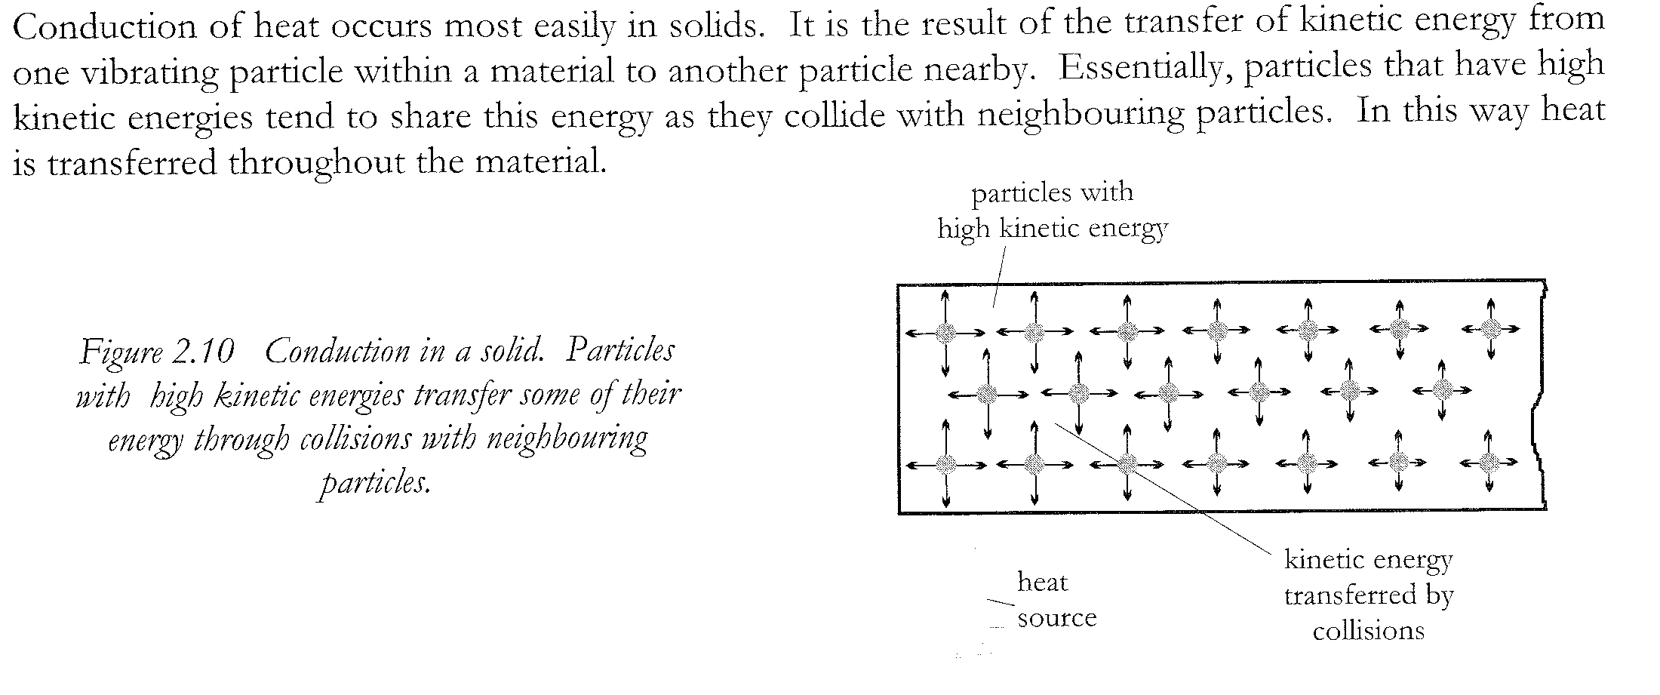
Conduction

Slide 7
Conduction
A blacksmith heats up the shoe in a fire, pounds on it with a mallet to shape it, and then cools it by dipping it in a bucket of water. Because the water is colder, thermal energy flows from the shoe to the water--quickly at first, and more slowly as the shoe cools. The water molecules, with little kinetic energy, are in direct contact with the iron atoms, which are jiggling rapidly and have lots of kinetic energy. When an iron atom bumps into a water molecule, the iron atom slows down a bit, while the water molecule speeds up (an elastic collision). In this way water gains the heat energy that the iron loses.
water molecule
iron atom
zoomed in view

Slide 8
Convection

Slide 9
Convection
The water near the hot horseshoe is warmer than the water further from the shoe. This warm water is lower in density than the cooler water, since its molecules are moving faster and taking up more space. With lower density, the warm water begins to float to the surface, carrying its heat energy with it. As it rises to the surface it cools and becomes denser. Then it begins to sink, warmer water from below taking its place. These convection currents transfer heat from the horseshoe to the air via the water, which is the convection medium.
If the water were surrounded by something solid or too viscous to flow, heat could only be transferred to the air via conduction, and it would take much longer. Convection plays a big role in determining global weather patterns.

Slide 10
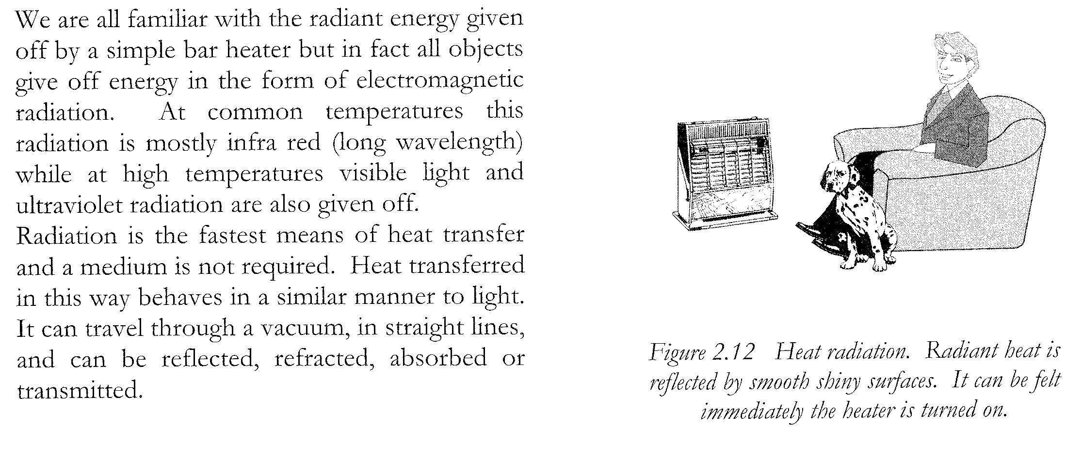
Radiation

Slide 11
Radiation
The molecules of warm water cooling the horseshoe at the surface of the open bucket bump into air molecules and transfer heat to the air via conduction. The water can also transfer energy to the air by emitting electromagnetic radiation. This is simply light, but usually it’s light of a wavelength that is too long for us to see--infrared. Bodies also continually absorb radiation, but when a body is warmer
than its surroundings, it emits more than it absorbs. Night vision technology takes advan-tage of this fact by detecting infrared light in order to “see in the dark.” Radiation can cool or warm objects even if they are surrounded by a vacuum. (Even a perfect Thermos bottle full of hot chocolate will eventually cool down.) When the bucket cools long enough, it will be in thermal equilibrium with the air, and the net radiation (emission - absorption) will be zero.

Slide 12
Summary table Using ticks and crosses complete the table below showing the relative ability of each heat transfer method in the 4 different mediums
 | Solid | Liquid | Gas | Vacuum
Conduction
Convection
Radiation

Slide 13
Cooling

Slide 14
Evaporative Air Conditioning

Slide 15
Evaporative Air Conditioning

Slide 16
Refrigerative Air Conditioning

Slide 17
Refrigerative Air Conditioning

Slide 18
Insulation
Air, Bricks and Wood are good insulators.
Things which trap air prevent heat transfer
eg double glazed windows,
jumpers,
carpet,
double leaf brickwork.
curtains

Slide 19
Home Insulation

Slide 20
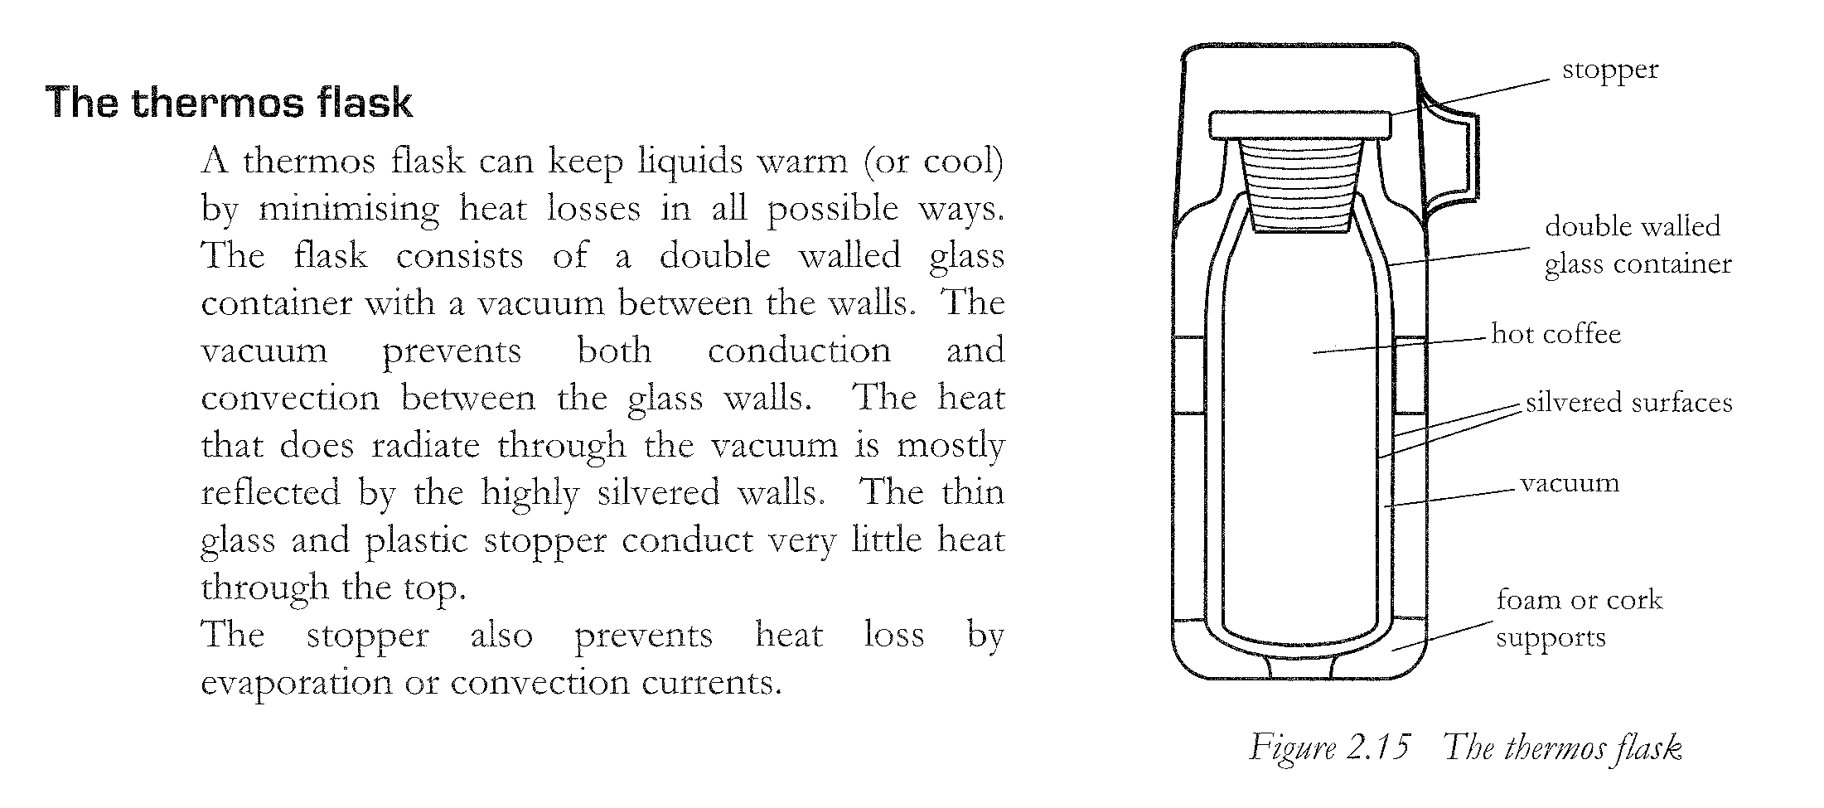
Thermos flasks

Slide 21
Problem 1

Slide 22
Problem 1 solution

Slide 23
Problem 2

Slide 24
Problem 2 solution

Slide 25
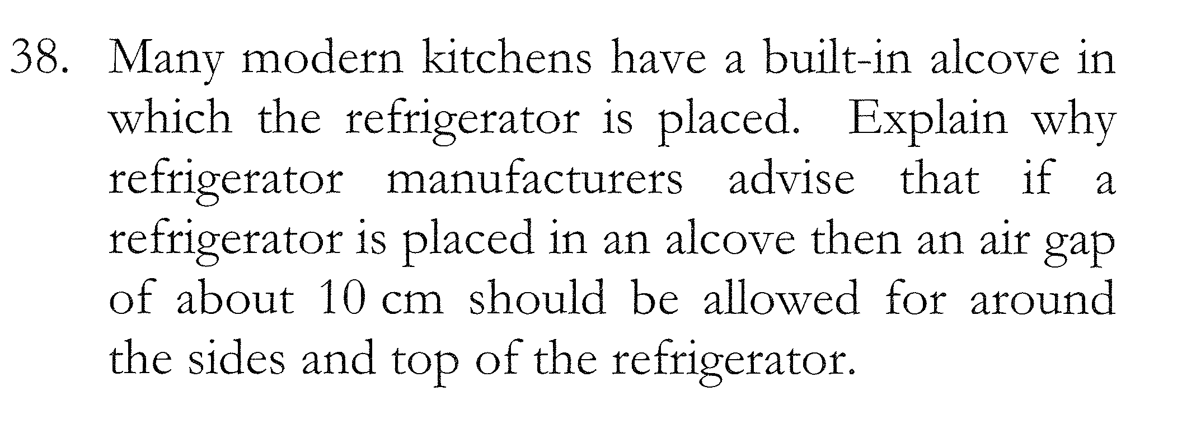
Problem 3

Slide 26
Problem 3 solution

Slide 27
Success Criteria
Can you describe the 3 methods of heat transfer with reference to the kinetic theory of matter?
Can you explain why we feel cooler when we sweat?
Can you describe (with diagrams) the operation of evaporative air-conditioners?
Can you describe (with diagrams) the operation of refrigerative air-conditioners?
Can you explain how items combat heat transfer, including houses, thermos flasks etc?

Slide 28
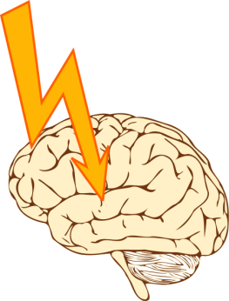

Student Feedback
What I learnt today…..
What I need to revise….
Images by clipart

